Slide 1
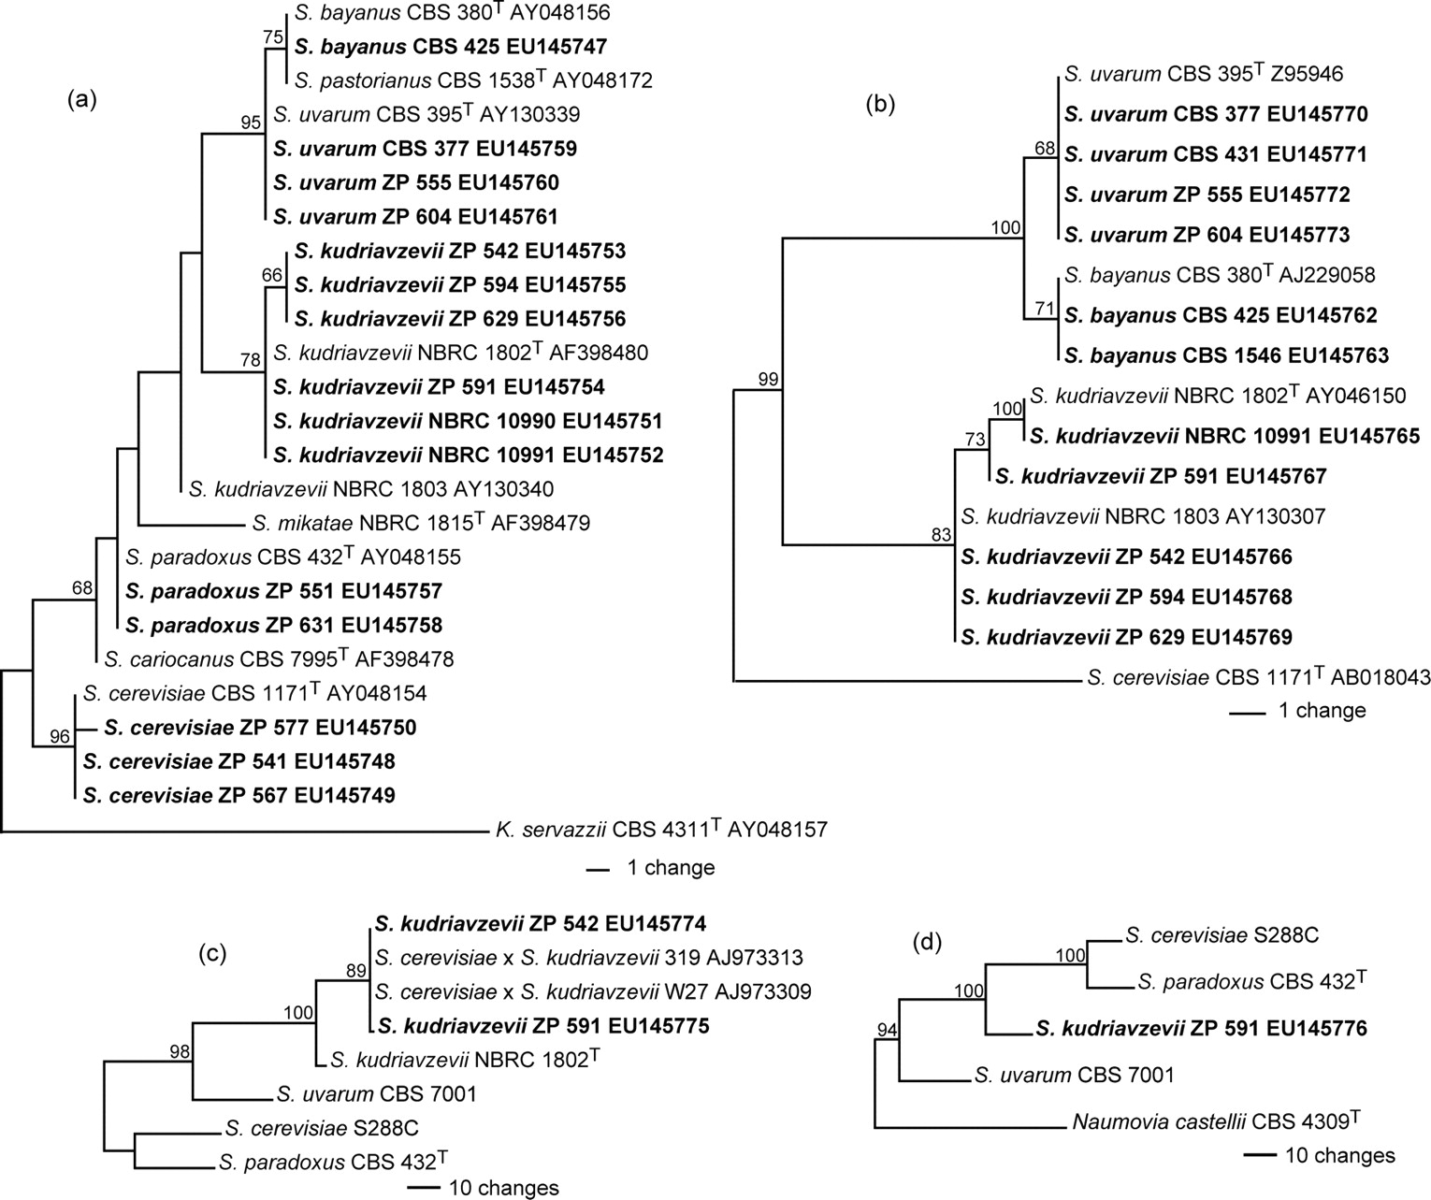
Maximum-parsimony phylogenetic trees of Saccharomyces spp. obtained with sequences of D1/D2 domains of the 26S rDNA (a), complete ITS region (ITS1, 5.8S, and ITS2) (b), partial nuclear MET6 gene (c), and partial GAL1 gene (d).
Sampaio J P , Gonçalves P Appl. Environ. Microbiol. 2008;74:2144-2152
Notes:
Maximum-parsimony phylogenetic trees of Saccharomyces spp. obtained with sequences of D1/D2 domains of the 26S rDNA (a), complete ITS region (ITS1, 5.8S, and ITS2) (b), partial nuclear MET6 gene (c), and partial GAL1 gene (d). The organisms chosen to root the trees were Kazachstania servazzii (a), S. cerevisiae (b), S. cerevisiae and S. paradoxus (c), and Naumovia castellii (d). The D1/D2, ITS, and GAL1 trees are the single most parsimonious trees, and the MET6 tree is a consensus tree of the 15 most parsimonious trees. Numbers at the nodes are bootstrap values (1,000 replicates; values below 50% are not shown). GenBank accession numbers of the sequences are indicated after strain designations. The sequences without GenBank accession numbers were retrieved from the fungal sequence alignment section of the SGD (http://www.yeastgenome.org/). Sequences determined in this study are shown in boldface type. Type strains are indicated with a superscript T.

